Slide 1
Poisoning Whitworth’s Network
Team VAM
Vina Le
Andrew Hutson
McKenna Galle
17FA CS313 Networks
DISCLAIMER: We did not poison any public network. No Whitworth networks were harmed in the making of this project.

Slide 2
Our Inspiration
Wanted to incorporate a raspberry pi into networks.
Test our skills in using a different operating system.
Realized how impacting ARP poisoning can be.
The legal and ethical issues behind the poisoning.

Slide 3
The Program
Program uses a raspberry pi to run Ubuntu Mate.
Raspberry pi joins the router’s network.
Victim’s computer thinks that the pi is the router.
Re-routes the user to a website of choice.
Uses mitmproxy as a re-routing tool.

Slide 4
Challenges
Due to ethical reasons, this project was carried out off campus and separate from Whitworth’s network.
Installing and configuring the raspberry pi’s operating system.
Connecting the raspberry pi to the network.
Using the pi to re-route user to the poisoner’s website of choice.
Working around HTTPS://

Slide 5
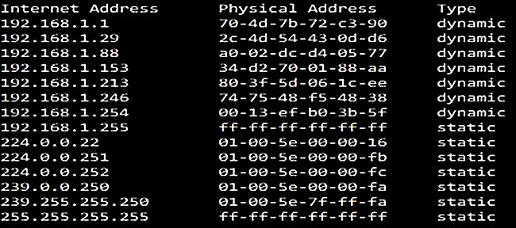
Demonstration
First number series displays the gateway IP address
Second series displays the raspberry pi’s IP address

Slide 6
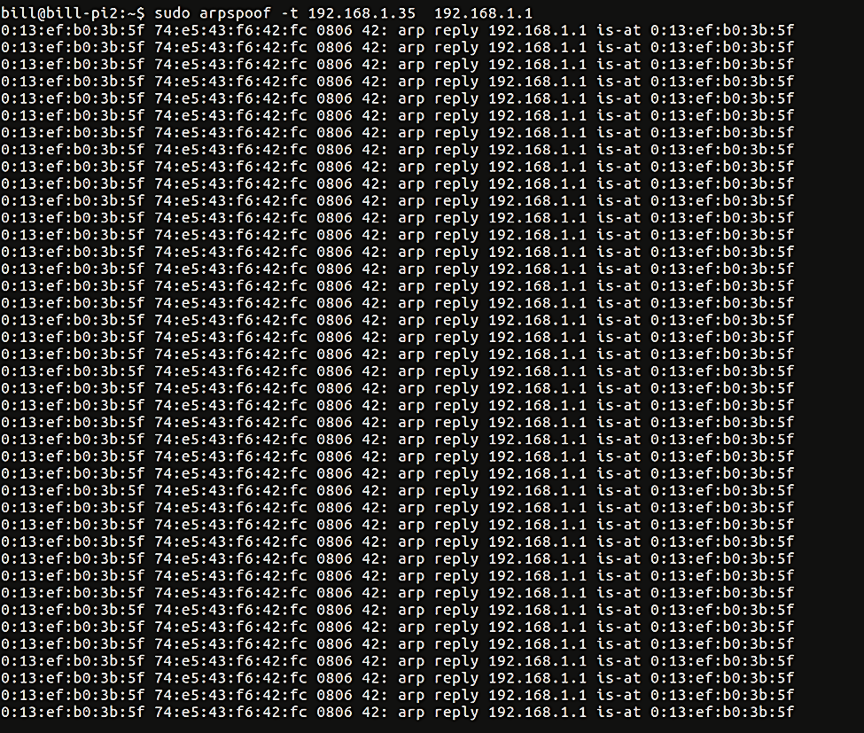
Not pictured: our gateway IP address
Victim has successfully connected to the raspberry pi.
The victim’s computer is now listening to the responses outputted by the pi.

Slide 7
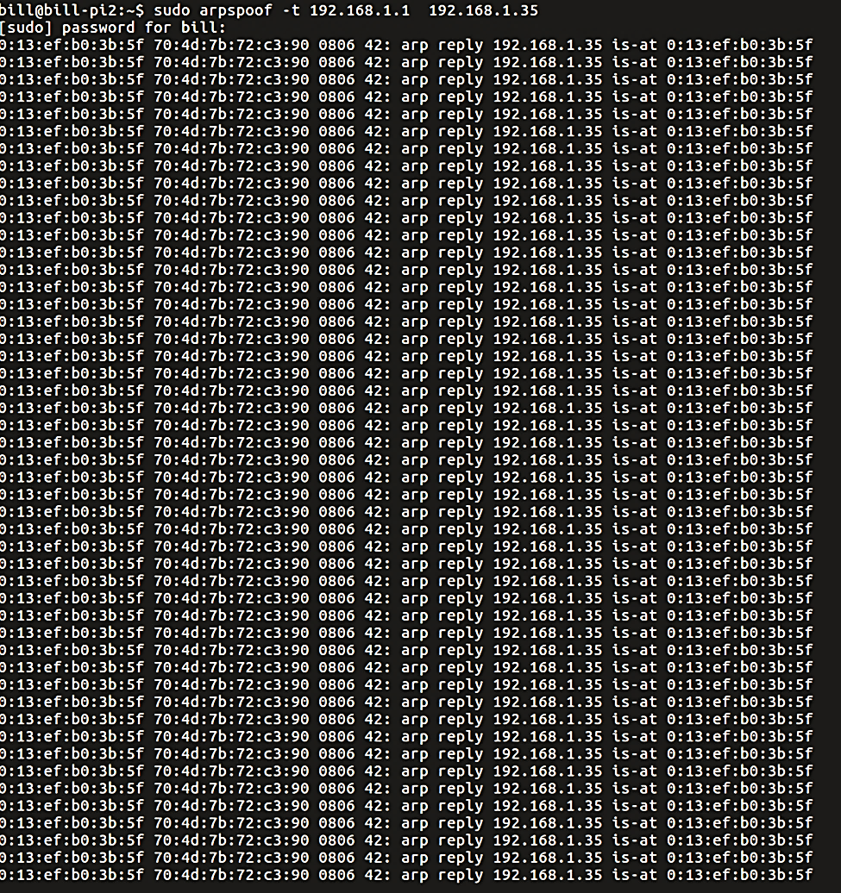
Not pictured: our victim’s IP address
The raspberry pi is now listening to the victim’s packets.
Victim has no internet access.

Slide 8
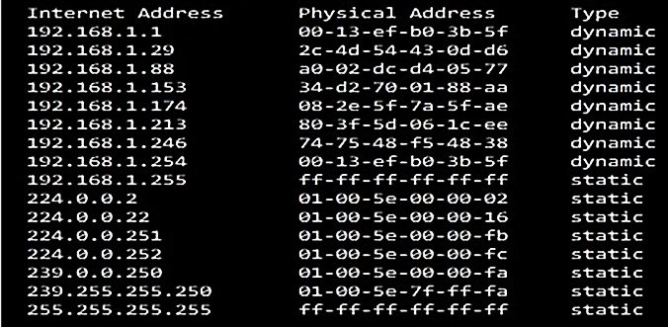
The physical addresses match!
Meaning the victim’s computer thinks the raspberry pi is the router.
Not displayed: all IP addresses on the network

Slide 9
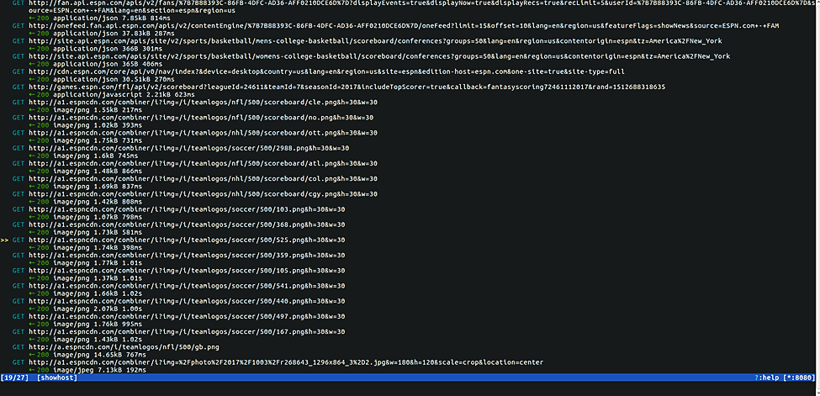
Using mitmproxy, the GET commands are intercepted by the raspberry pi.

Slide 10
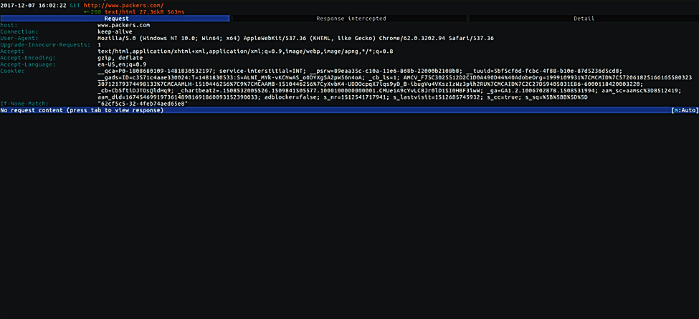
The raspberry pi’s GET Response is blocking the victim’s request from being delivered to the router.

Slide 11
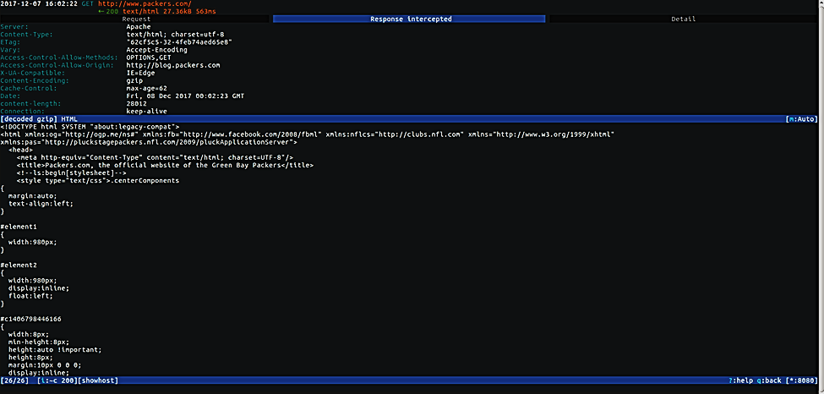
The raspberry pi is intercepting the GET Response and the HTML header is displayed.

Slide 12
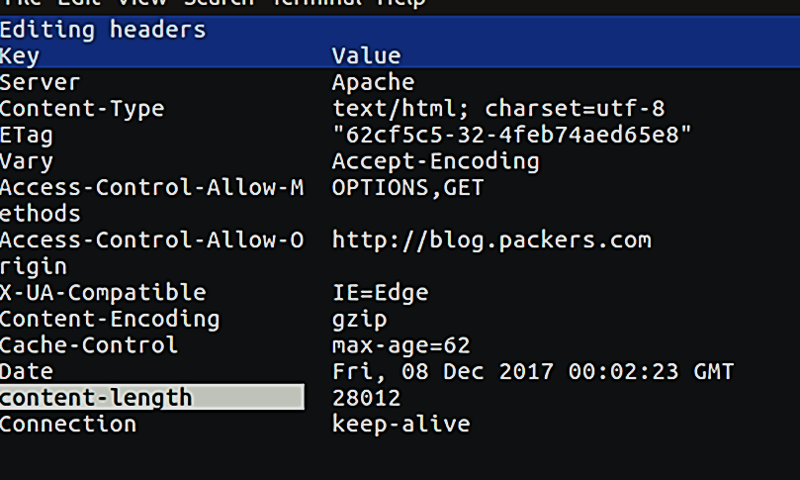
GET response’s header
The Content-Encoding is replaced with Location.
gzip is replaced with the URL that the poisoner wants the victim to access.

Slide 13
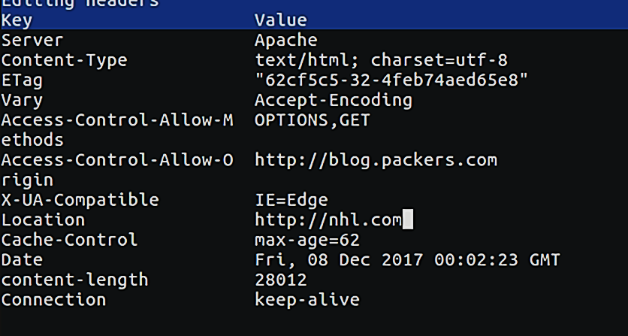
GET response’s header
The Content-Encoding is replaced with Location.
gzip is replaced with the URL that the poisoner wants the victim to access.

Slide 14
Further Research
Doing ARP poisoning using C++
Rerouting the victim’s hardware address and sending them to a user-made address:
http://libtins.github.io/examples/arp-spoof/

Slide 15

Ending
Any nice, generous criticism or questions are appreciated.
Sources:
McKenna’s Dad
mitmproxy’s main website
https://mitmproxy.org/

